Slide 1
Department of Applied Mathematics and Computational Sciences
III Sem M.Sc.Software Systems
Transform Techniques
Dr. V. Suresh kumar

Slide 2
Transform of standard functions

Slide 3
Trigonometric functions
Solution:

Slide 4
Hyperbolic functions

Slide 5
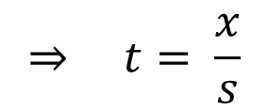
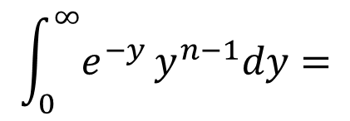
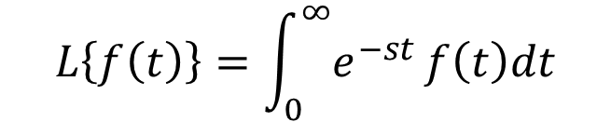
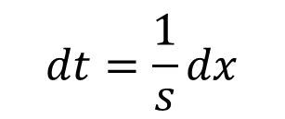
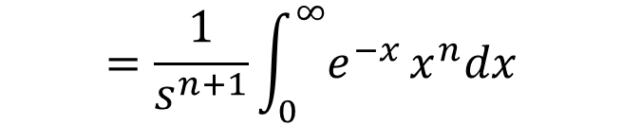


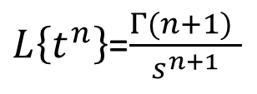
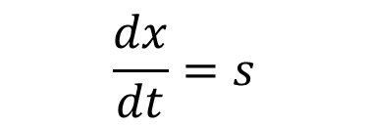
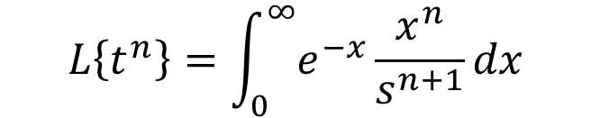

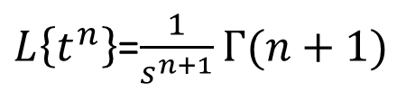
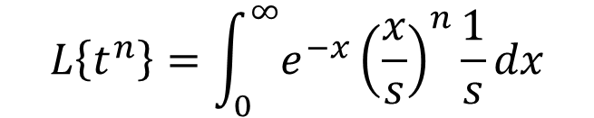
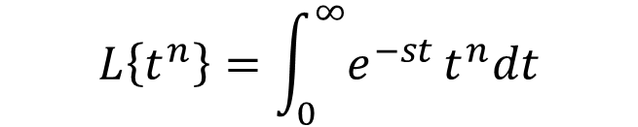
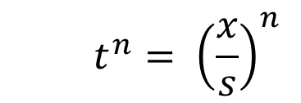

Algebraic function
Find the Laplace Transform of $f\left(t\right)=t^{n}$
$$L\left\{t^{n}\right\}=\int_{0}^{∞}{e^{−x}}\frac{x^{n}}{s^{n+1}}dx$$
Solution:
We have
$$L\left\{f\left(t\right)\right\}=\int_{0}^{∞}{e^{−st}}f\left(t\right)dt$$
$$=\frac{1}{s^{n+1}}\int_{0}^{∞}{e^{−x}}x^{n}dx$$
$$L\left\{t^{n}\right\}=\int_{0}^{∞}{e^{−st}}t^{n}dt$$
Since
$$Γ(n+1)$$
$$\int_{0}^{∞}{e^{−y}}y^{n−1}dy=$$
$$Γ(n)$$
Put $x=st$
$$⇒ t= \frac{x}{s}$$
$$\frac{dx}{dt}=s$$
$$t^{n}= {\left(\frac{x}{s}\right)}^{n}$$
$L\left\{t^{n}\right\}$=$\frac{1}{s^{n+1}}Γ(n+1)$
$$dt=\frac{1}{s}dx$$
$$L\left\{t^{n}\right\}=\int_{0}^{∞}{e^{−x}}{\left(\frac{x}{s}\right)}^{n}\frac{1}{s}dx$$
$L\left\{t^{n}\right\}$=$\frac{Γ(n+1) }{s^{n+1}}$

Slide 6

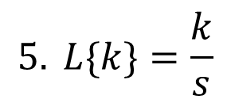
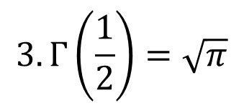


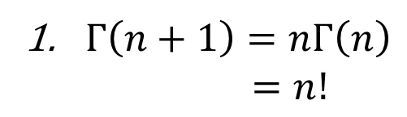
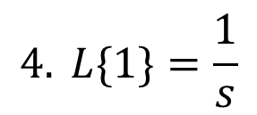





Note:
$Γ\left(n+1\right)=nΓ\left(n\right)$
$=n!$
Provided $n$ is a positive integer
$$2. Γ\left(1\right)=1$$
In addition, we have
$$3. Γ\left(\frac{1}{2}\right)=\sqrt{π}$$
$$\frac{1}{s^{2}}$$
$$L\{t\}=$$
$$\frac{2}{s^{3}}$$
$$4. L\{1\}=\frac{1}{s}$$
$$L\{t^{2}\}=$$
$$\frac{6}{s^{4}}$$
$$L\{t^{3}\}=$$
$$5. L\{k\}=\frac{k}{s}$$
and so on …

Slide 7


